Slide 1
Pattern recognition in sky images
Samuel Monsarrat
Jordi Lladós
Md Zilan Uddn Saif

Slide 2
Table of contents
State of the art
Data acquisition
Image preprocessing
PCA
Neural network
Conclusion

Slide 3
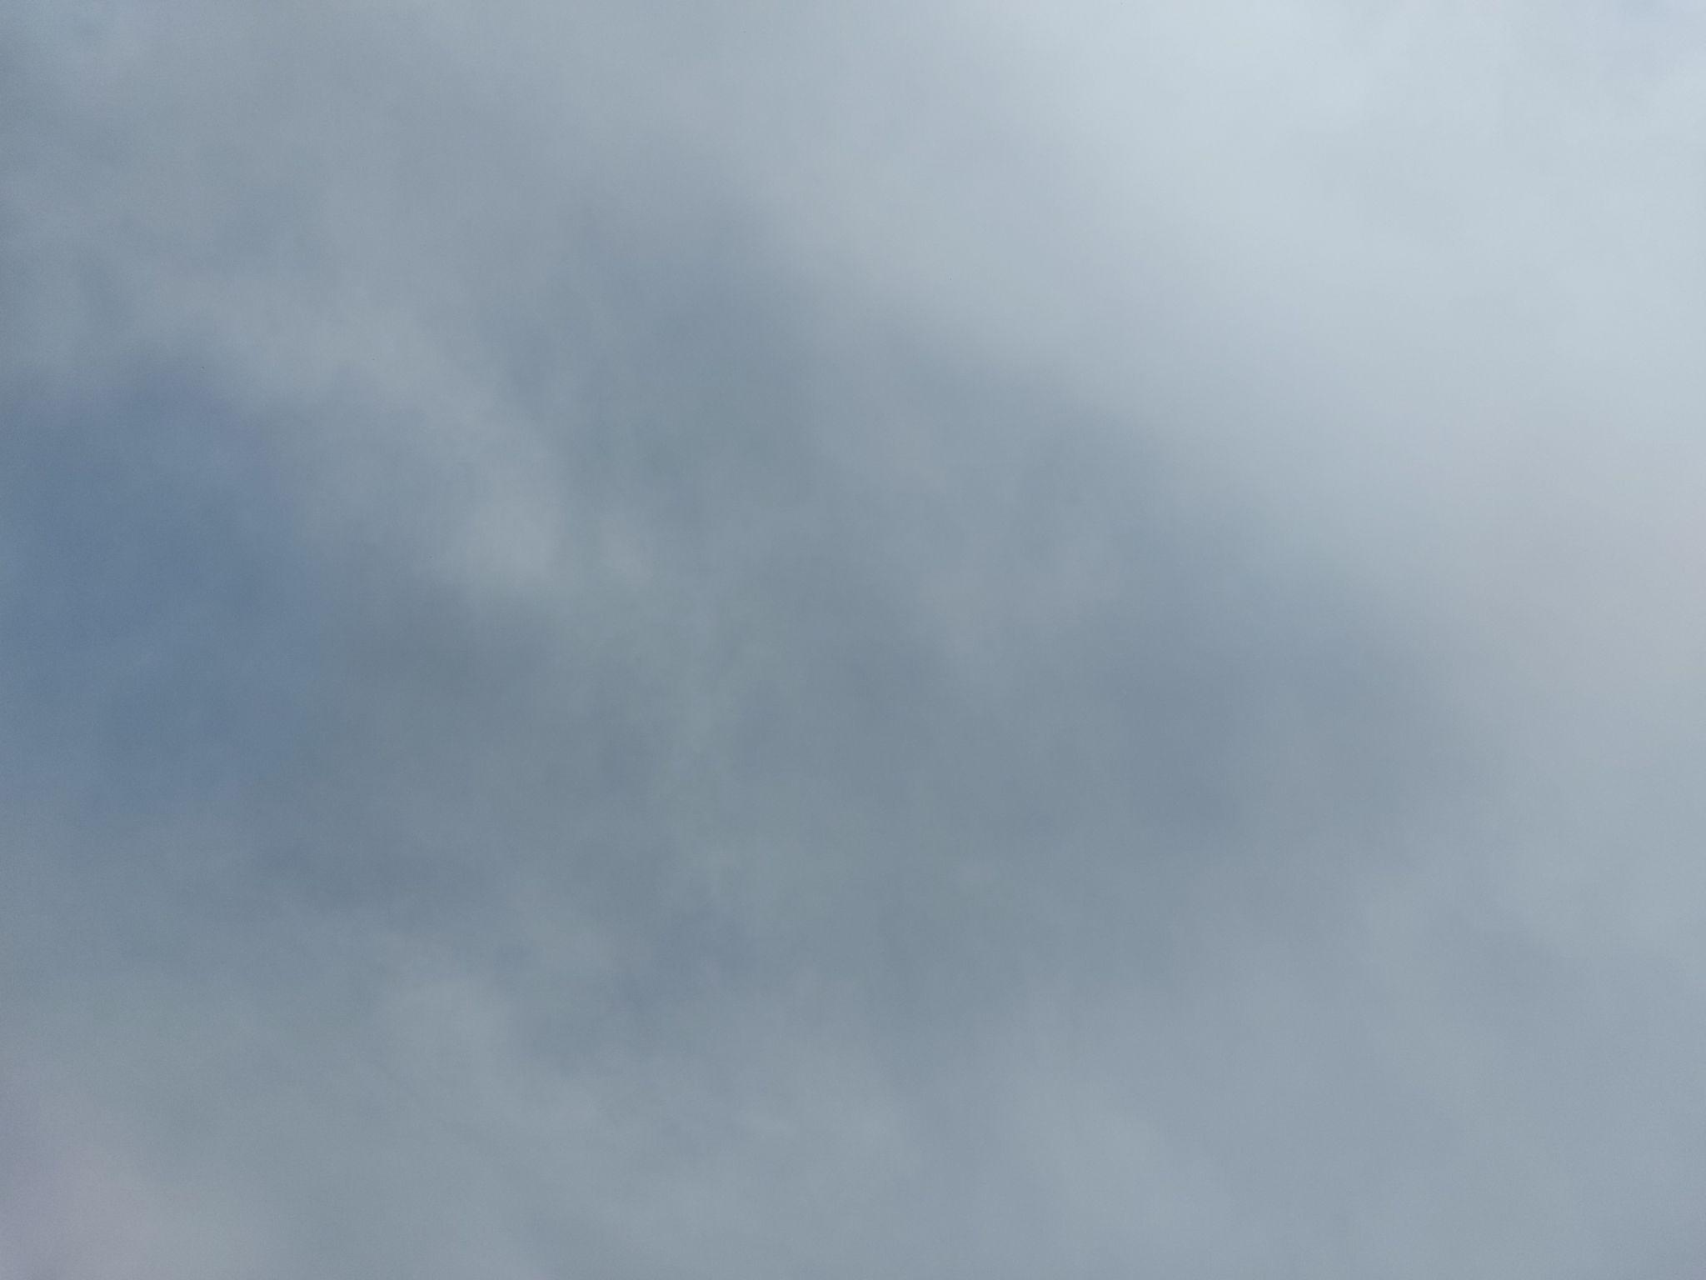



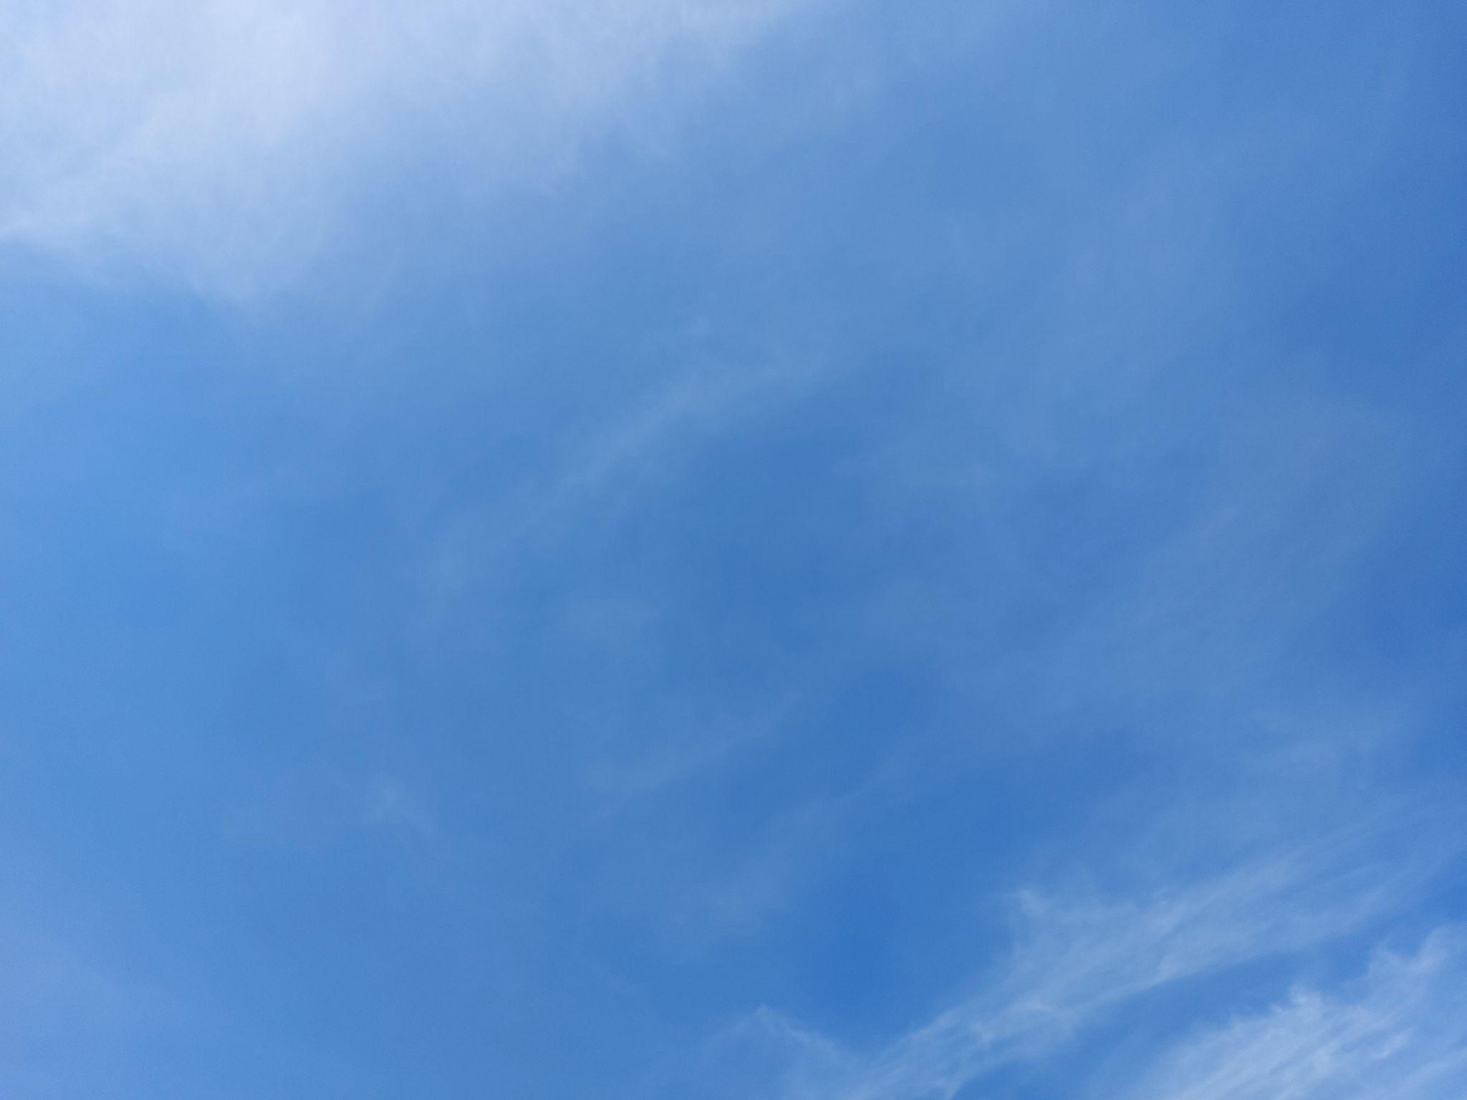
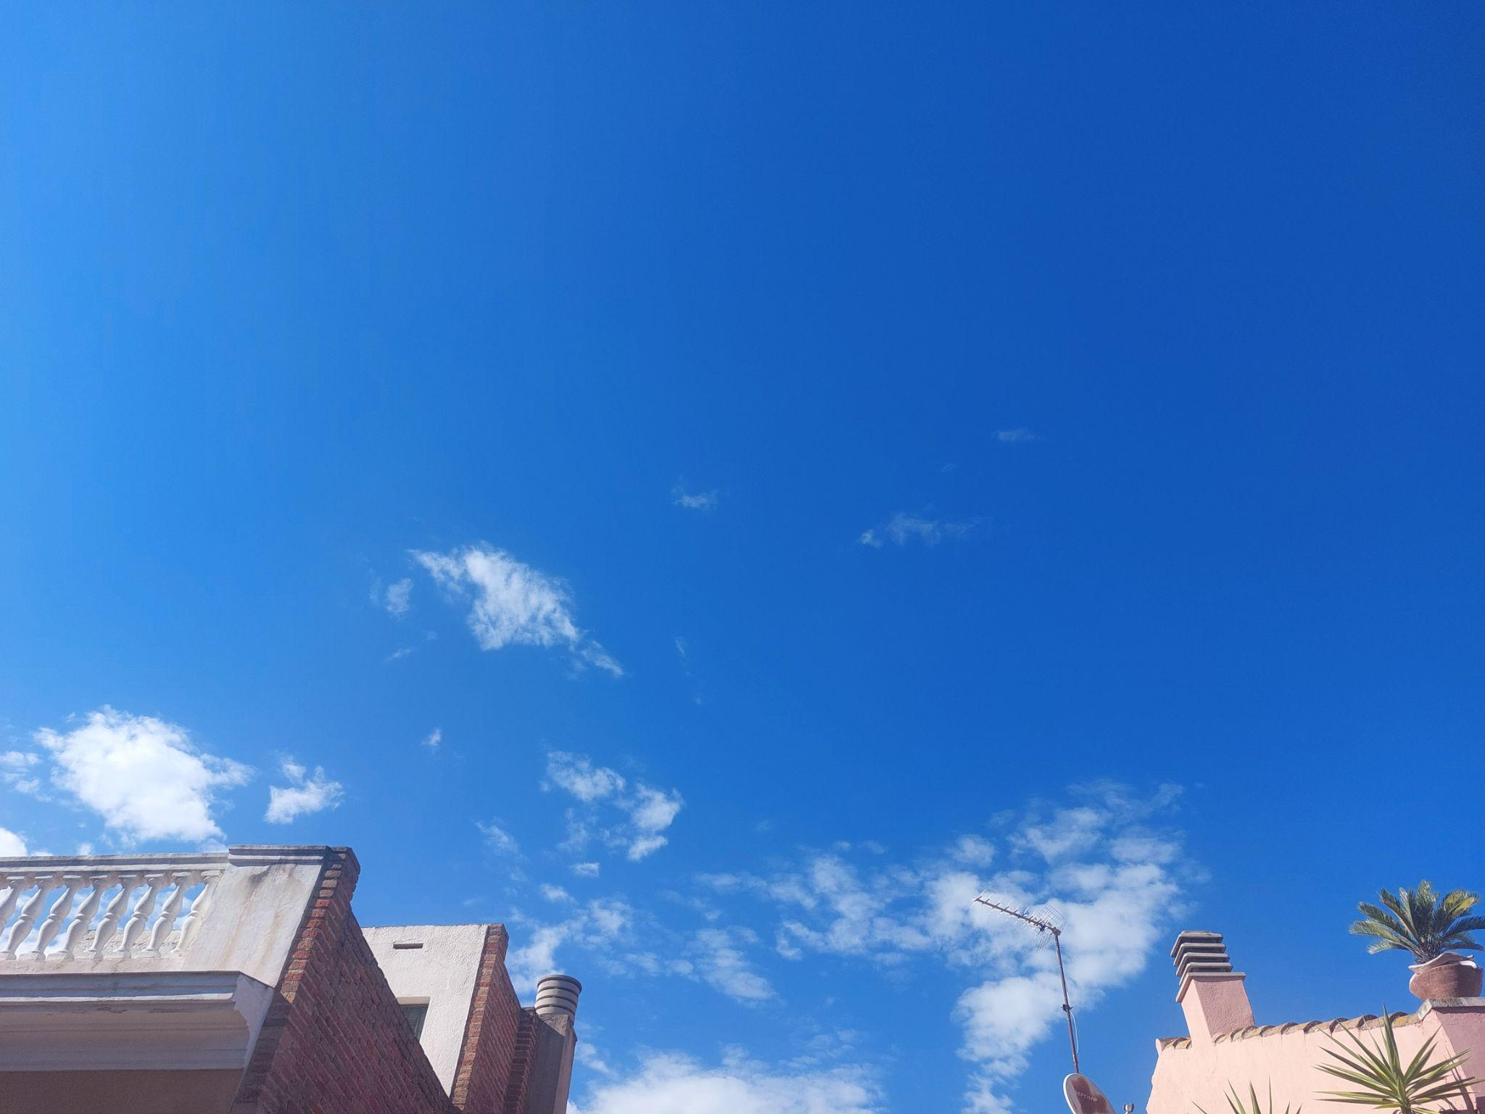

Data acquisition
8 AM
12 PM
4 PM
8 PM

Slide 4





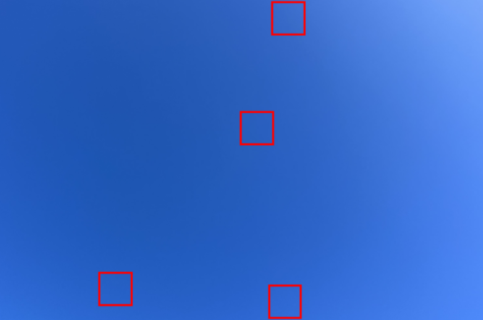


Image preprocessing
Patch 1
Patch 2
Original image
Size reduction
Original image cropped
Random patches selection
+
Patch 3
White pixels (R>150, G>150, B>150) ->Replaced by the mean of the patch’s blue pixels
Patch 4

Slide 5
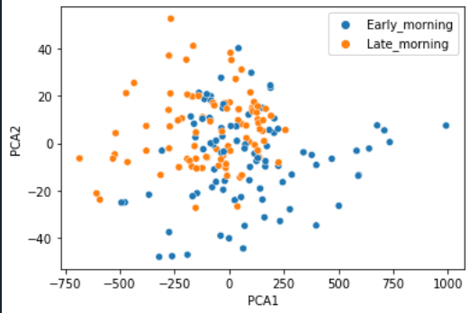
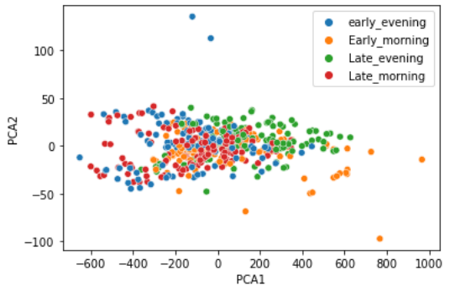
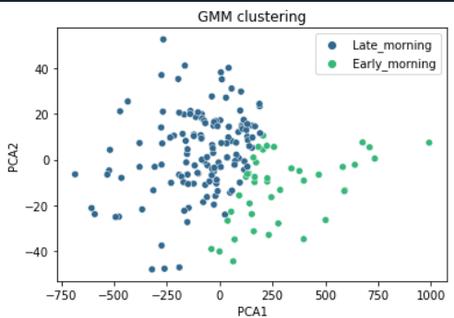
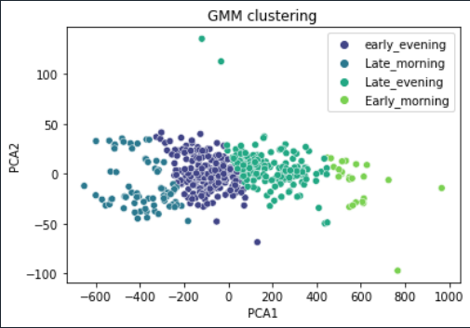
PCA
Get only the red channel
Flatten red channel
Split data in a train and a test set
Standardize the data
Perform PCA
Classify using GMM
Assign each cluster to a labe
Calculate performance indexes
PCA with 2 classes
PCA with 4 classes
GMM with 2 classes
GMM with 4 classes

Slide 6
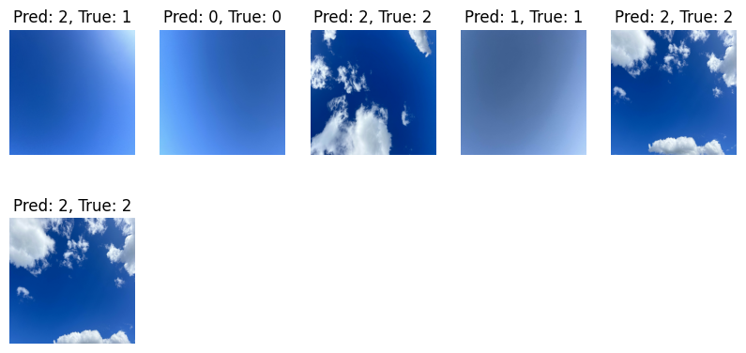
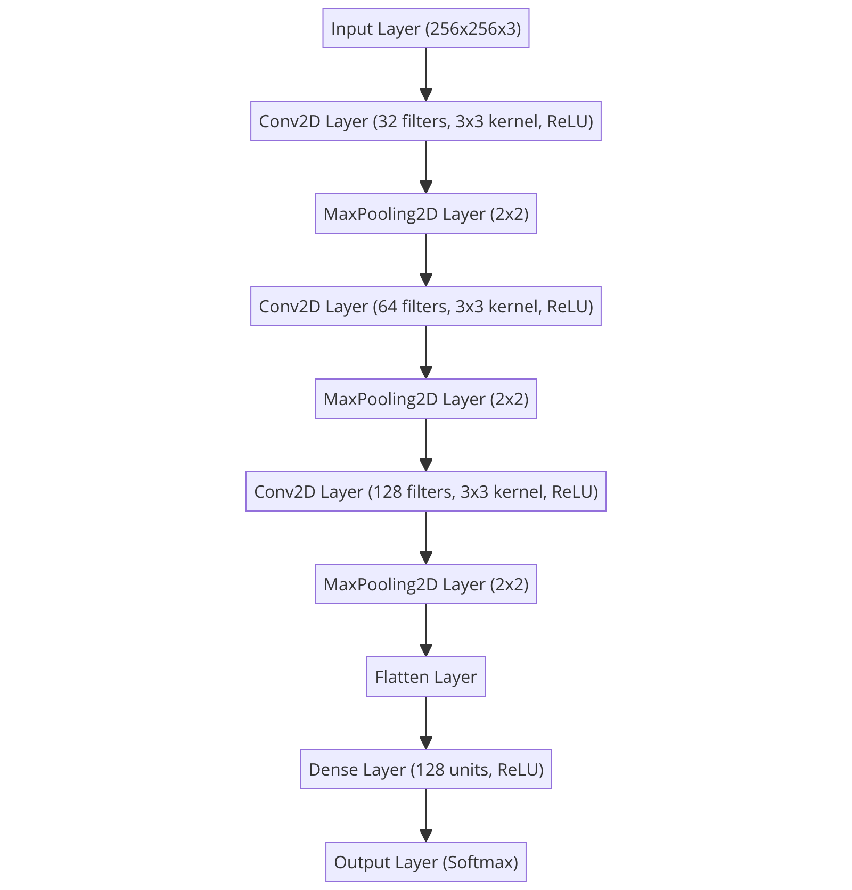
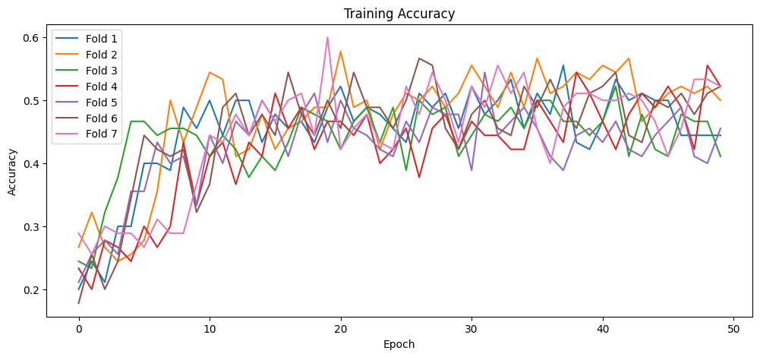
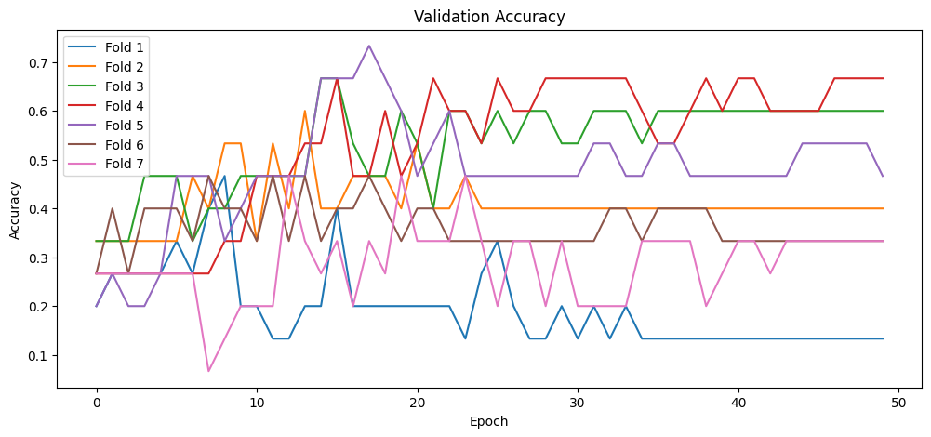
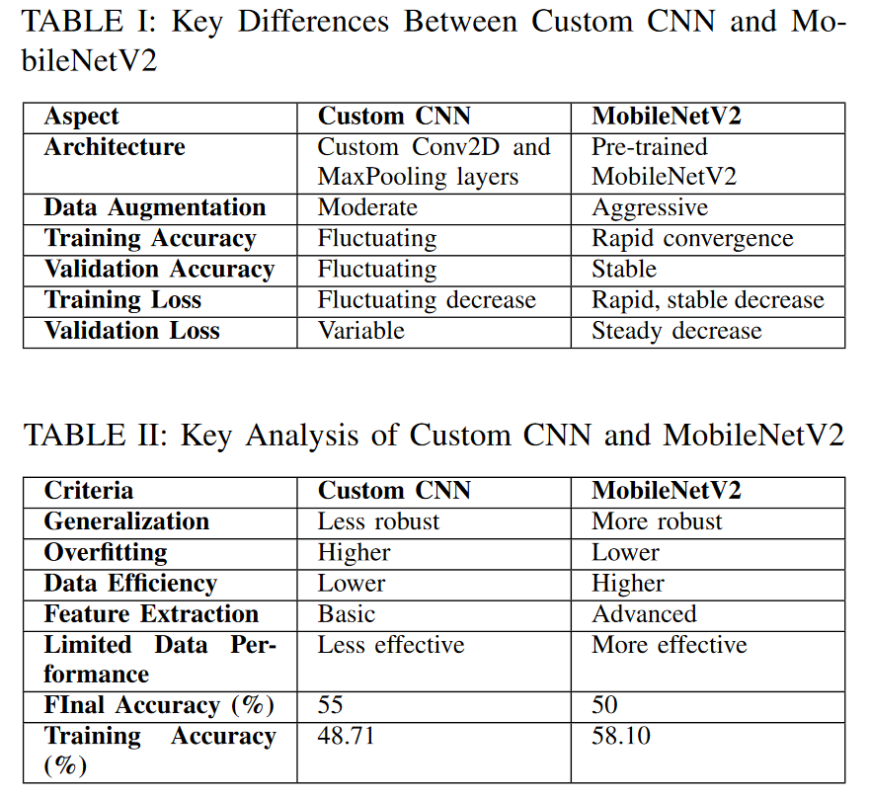
Neural network

Slide 7
Conclusion
We met our objectives
PCA, GMM and CNN for sky recognition
Possible improvements for better accuracy:
Implement an algorithm for every seasons
Take pictures with the same camera
Explore different approaches beyond the RGB channels

